Slide 1
Chapter 4: The Enhanced Entity-Relationship (EER) Model

Slide 2
Chapter 4 Outline
4.1 – Subtypes, Supertypes, and Inheritance
4.2 – Specialization and Generalization
4.3 – Constraints and Characteristics of Specialization and Generalization Hierarchies
4.4 – Modeling of UNION Types Using Categories

Slide 3
Chapter 4 Outline (cont’d.)
A Sample UNIVERSITY EER Schema, Design Choices, and Formal Definitions
Example of Other Notation: Representing Specialization and Generalization in UML Class Diagrams
Data Abstraction, Knowledge Representation, and Ontology Concepts

Slide 4
The EER Model
Enhanced Entity-Relationship (EER) Model
Created to design more accurate database schemas
Reflect the data properties and constraints more precisely than the ER Model alone
More complex requirements than traditional applications

Slide 5
The EER Model
EER model includes all modeling concepts of the ER model
In addition, EER includes:
Subtypes and supertypes
Analogous to subclasses and superclasses of OOP
Attribute and relationship inheritance
The process of specialization and generalization
Conceptual constraints (contrast with data constraints)
Category or union type (similar to C-style unions)

Slide 6
4.1 Subclasses, Superclasses, and Inheritance

Slide 7
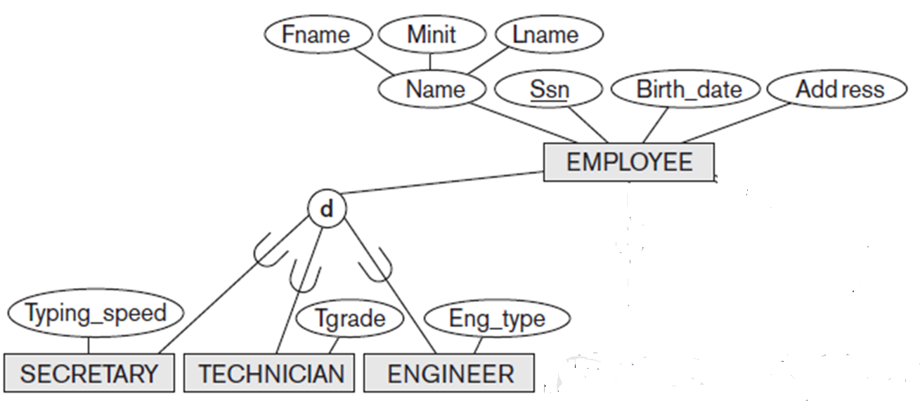
The EER Model
Subtype (or subclass) of an entity type
Sub-groupings of entity instances that are meaningful
Represented explicitly because of their significance to the database application
Notes:
For example, the entities that are members of the EMPLOYEE entity type may be distinguished further into SECRETARY, ENGINEER, MANAGER, TECHNICIAN, SALARIED_EMPLOYEE, HOURLY_EMPLOYEE, and so on.
The set of entities in each of the latter groupings is a subset of the entities that belong to the EMPLOYEE entity set, meaning that every entity that is a member of one of these subgroupings is also an employee. We call each of these sub-groupings a subclass or subtype of the EMPLOYEE entity type, and the EMPLOYEE entity type is called the superclass or supertype for each of these subclasses.

Slide 8
Specialization and Generalization (cont’d.)
Two main reasons for including class/subclass relationships and specializations in a data model:
Certain attributes may apply to some but not all entities of the superclass
Some relationship types may be participated in only by members of the subclass
Notes:
There are two main reasons for including class/subclass relationships and specializations in a data model.
The first is that certain attributes may apply to some but not all entities of the superclass. A subclass is defined in order to group the entities to which these attributes apply. The members of the subclass may still share the majority of their attributes with the other members of the superclass. For example, in Figure 8.1 the SECRETARY subclass has the specific attribute Typing_speed, whereas the ENGINEER subclass has the specific attribute Eng_type, but SECRETARY and ENGINEER share their other inherited attributes from the EMPLOYEE entity type.
The second reason for using subclasses is that some relationship types may be participated in only by entities that are members of the subclass. For example, if only HOURLY_EMPLOYEES can belong to a trade union, we can represent that fact by creating the subclass HOURLY_EMPLOYEE of EMPLOYEE and relating the subclass to an entity type TRADE_UNION via the BELONGS_TO relationship type,

Slide 9
Subclasses, Superclasses, and Inheritance (cont’d.)
Terms for the relationship between a superclass and any one of its subclasses
Supertype/subtype
Superclass/subclass
Class/subclass relationship
Type inheritance
Subclass entity inherits all attributes and relationships of superclass
Notes:
An important concept associated with subclasses (subtypes) is that of type inheritance. Recall that the type of an entity is defined by the attributes it possesses and the relationship types in which it participates. Because an entity in the subclass represents the same real-world entity from the superclass, it should possess values for its specific attributes as well as values of its attributes as a member of the superclass. We say that an entity that is a member of a subclass inherits all the attributes of the entity as a member of the superclass. The entity also inherits all the relationships in which the superclass participates.
A class/subclass relationship is often called an IS-A (or IS-AN) relationship because of the way we refer to the concept. We say a SECRETARY is an EMPLOYEE, a TECHNICIAN is an EMPLOYEE, and so on.

Slide 10
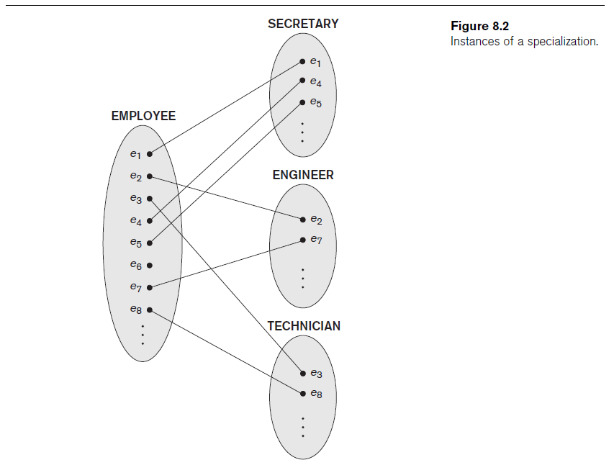
Entity Subsets
Entity Subsets
I believe that this textbook figure is misleading. It seems to indicate that there are multiple instances of e1.
Is this another e1 instance ????
Entity Set
10

Slide 11
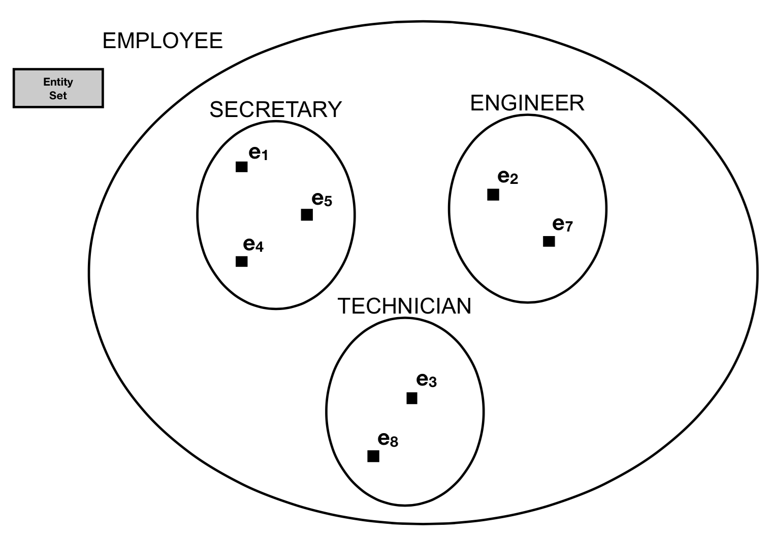
Entity Subsets
Entity Set
Notes:
FIXME: add e6

Slide 12
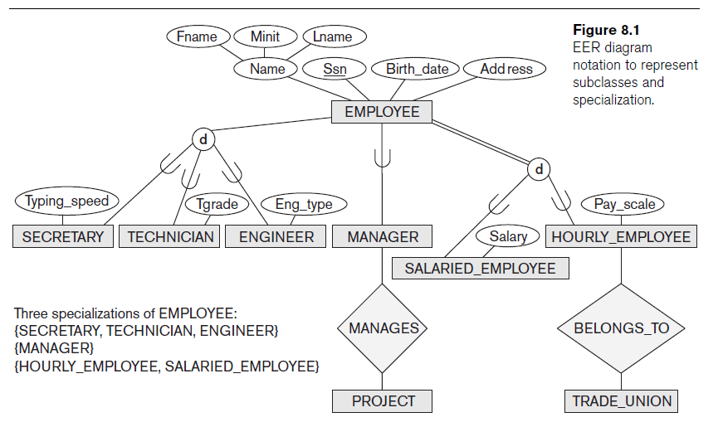
Subclass and Specialization
Figure 4.1
EER diagram notation to represent subclasses and specialization.
Notes:
Like ER, I’ll show the full diagram first

Slide 13
4.2 Specialization and Generalization

Slide 14
Specialization and Generalization
Specialization
Process of defining a set of subclasses of an entity type
Defined on the basis of some distinguishing characteristic of the entities in the superclass
Subclass can define:
Specific attributes
Specific relationship types
Notes:
Specialization is the process of defining a set of subclasses of an entity type; this entity type is called the superclass of the specialization. The set of subclasses that forms a specialization is defined on the basis of some distinguishing characteristic of the entities in the superclass.
For example, the set of subclasses {SECRETARY, ENGINEER, TECHNICIAN} is a specialization of the superclass EMPLOYEE that distinguishes among employee entities based on the job type of each employee entity.
The subclasses that define a specialization are attached by lines to a circle that represents the specialization, which is connected in turn to the superclass. The subset symbol on each line connecting a subclass to the circle indicates the direction of the superclass/subclass relationship.
Attributes that apply only to entities of a particular subclass—such as TypingSpeed of SECRETARY—are attached to the rectangle representing that subclass. These are called specific attributes (or local attributes) of the subclass.
Similarly, a subclass can participate in specific relationship types, such as the HOURLY_EMPLOYEE subclass participating in the BELONGS_TO relationship in the previous Figure.

Slide 15
Generalization
Reverse process of specialization, which is abstraction
Generalize into a single superclass
Original entity types are special subclasses
Generalization
Process of defining a generalized entity type from the given entity types
Notes:
We can think of a reverse process of abstraction in which we suppress the differences among several entity types, identify their common features, and generalize them into a single superclass of which the original entity types are special subclasses.
EXAMPLE ON THE NEXT SLIDE

Slide 16
Generalization Example
Notes:
For example, consider the entity types CAR and TRUCK shown in the top Figures. Because they have several common attributes, they can be generalized into the entity type VEHICLE, as shown in Figure in the bottom half. Both CAR and TRUCK are now subclasses of the generalized superclass VEHICLE. We use the term generalization to refer to the process of defining a generalized entity type from the given entity types.
Notice that the generalization process can be viewed as being functionally the inverse of the specialization process. Therefore, in this Figure we can view {CAR, TRUCK} as a specialization of VEHICLE, rather than viewing VEHICLE as a generalization of CAR and TRUCK.
Similarly, in the earlier EMPLOYEE diagram, we can view EMPLOYEE as a generalization of SECRETARY, TECHNICIAN, and ENGINEER.

Slide 17
4.3 Constraints and Characteristics of Specialization and Generalization Hierarchies

Slide 18
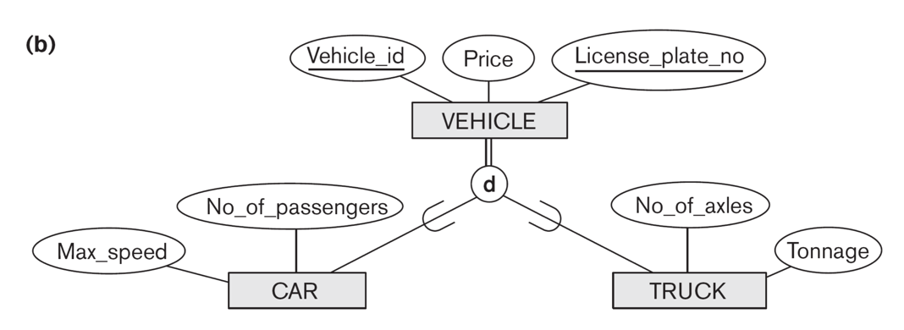
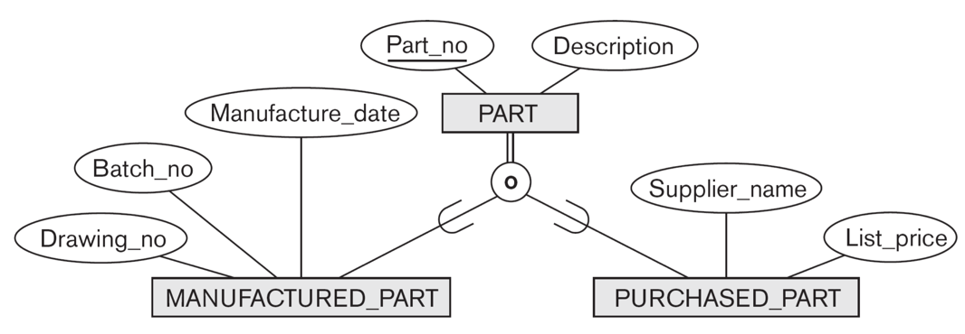
Constraints on Specialization and Generalization
Disjointness constraint
Specifies that the subclasses of the specialization must be disjoint
disjoint
overlap

Slide 19
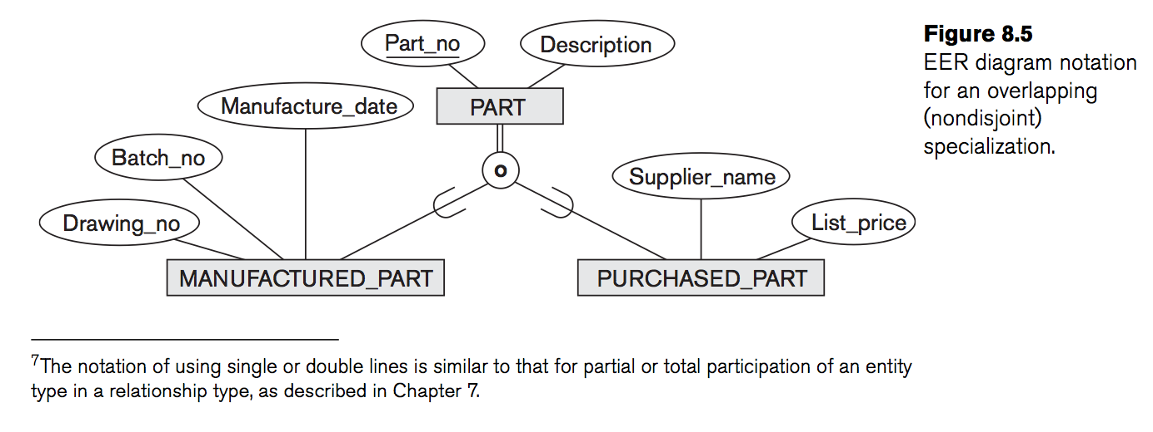
Constraints on Specialization and Generalization (cont’d.)
Completeness (or totalness) constraint
May be total or partial
Disjointness and completeness constraints are independent
total participation
Notes:
The second constraint on specialization is called the completeness (or totalness) constraint, which may be total or partial. A total specialization constraint specifies that every entity in the superclass must be a member of at least one subclass in the specialization.
For example, if every EMPLOYEE must be either an HOURLY_EMPLOYEE or a SALARIED_EMPLOYEE, then the specialization is a total specialization of EMPLOYEE. This is shown in EER diagrams by using a double line to connect the superclass to the circle. A single line is used to display a partial specialization, which allows an entity not to belong to any of the subclasses. For example, if some EMPLOYEE entities do not belong to any of the subclasses {SECRETARY, ENGINEER, TECHNICIAN}, then that specialization is partial.
The Disjointness and completeness constraints are independent

Slide 20
Specialization and Generalization Hierarchies and Lattices
Specialization hierarchy
Every subclass participates as a subclass in only one class/subclass relationship
Results in a tree structure or strict hierarchy
Specialization lattice
Subclass can be a subclass in more than one class/subclass relationship (i.e. multiple inheritance)
Notes:
A subclass itself may have further subclasses specified on it, forming a hierarchy or a lattice of specializations. For example, ENGINEER is a subclass of EMPLOYEE and is also a superclass of ENGINEERING_MANAGER; this represents the real-world constraint that every engineering manager is required to be an engineer. A specialization hierarchy has the constraint that every subclass participates as a subclass in only one class/subclass relationship; that is, each subclass has only one parent, which results in a tree structure or strict hierarchy. In contrast, for a specialization lattice, a subclass can be a subclass in more than one class/subclass relationship.

Slide 21
Specialization and Generalization Hierarchies and Lattices
partial
total

Slide 22
Specialization and Generalization Hierarchies and Lattices (cont’d.)
Multiple inheritance
Subclass with more than one superclass
If attribute (or relationship) originating in the same superclass inherited more than once via different paths in lattice
Included only once in shared subclass
Single inheritance
Some models and languages limited to single inheritance
Notes:
A subclass with more than one superclass is called a shared subclass, such as ENGINEERING_MANAGER in Figure 8.6. This leads to the concept known as multiple inheritance, where the shared subclass ENGINEERING_MANAGER directly inherits attributes and relationships from multiple classes. Notice that the existence of at least one shared subclass leads to a lattice (and hence to multiple inheritance); if no shared subclasses existed, we would have a hierarchy rather than a lattice and only single inheritance would exist.

Slide 23
Constraints on Specialization and Generalization
Determine entity subtype:
Predicate-defined (or condition-defined) subclasses
Attribute-defined specialization
User-defined
Notes:
When we do not have a condition for determining membership in a subclass, the subclass is called user-defined. Membership in such a subclass is determined by the database users when they apply the operation to add an entity to the subclass; Thus, membership is specified individually for each entity by the user, not by any condition that may be evaluated automatically.

Slide 24
Constraints on Specialization and Generalization
Determine entity subtype:
Predicate-defined (or condition-defined) subclasses
Predicate-defined subclass are displayed by writing the predicate condition next to the line that connects the subclass to the specialization circle.
Notes:
In general, we may have several specializations defined on the same entity type (or superclass), as shown in the EMPLOYEE Figure. In such a case, entities may belong to subclasses in each of the specializations. However, a specialization may also consist of a single subclass only, such as the {MANAGER} specialization of EMPLOYEE. In such a case, we do not use the circle notation.
In some specializations we can determine exactly the entities that will become members of each subclass by placing a condition on the value of some attribute of the superclass. Such subclasses are called predicate-defined (or condition-defined) subclasses.
For example, if the EMPLOYEE entity type has an attribute ((Job_type)), we can specify the condition of membership in the SECRETARY subclass by the condition (Job_type = ‘Secretary’), which we call the defining predicate of the subclass. This condition is a constraint specifying that exactly those entities of the EMPLOYEE entity type whose attribute value for Job_type is ‘Secretary’ belong to the subclass.
Predicate-defined subclass are displayed by writing the predicate condition next to the line that connects the subclass to the specialization circle.

Slide 25
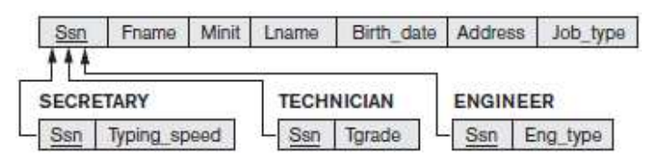
Constraints on Specialization and Generalization
May be several or one subclass
Determine entity subtype:
Predicate-defined (or condition-defined) subclasses
Attribute-defined specialization
Notes:
If all subclasses in a specialization have their membership condition on the same attribute of the superclass, the specialization itself is called an attribute-defined specialization, and the attribute is called the defining attribute of the specialization. In this case, all the entities with the same value for the attribute belong to the same subclass. We display an attribute-defined specialization by placing the defining attribute name next to the arc from the circle to the superclass, as shown.

Slide 26
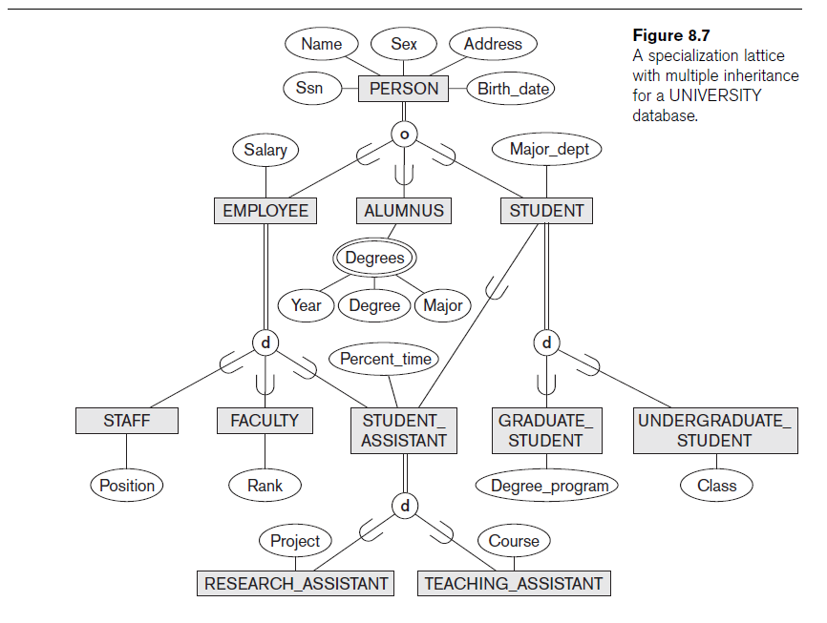
Specialization Lattice w/ Multiple Inheritance
Notes:
In this Figure, all person entities represented in the database are members of the PERSON entity type, which is specialized into the subclasses {EMPLOYEE, ALUMNUS, STUDENT}. This specialization is overlapping;
For example, an alumnus may also be an employee and may also be a student pursuing an advanced degree. The subclass STUDENT is the superclass for the specialization {GRADUATE_STUDENT, UNDERGRADUATE_STUDENT}, while EMPLOYEE is the superclass for the specialization {STUDENT_ASSISTANT, FACULTY, STAFF}. Notice that STUDENT_ASSISTANT is also a subclass of STUDENT.
Finally, STUDENT_ASSISTANT is the superclass for the specialization into {RESEARCH_ASSISTANT, TEACHING_ASSISTANT}.
In a specialization lattice or hierarchy like the previous slide, a subclass inherits the attributes not only of its direct superclass, but also of all its predecessor superclasses all the way to the root of the hierarchy or lattice if necessary. For example, an entity in GRADUATE_STUDENT inherits all the attributes of that entity as a STUDENT and as a PERSON. Notice that an entity may exist in several leaf nodes of the hierarchy, where a leaf node is a class that has no subclasses of its own.
For example, a member of GRADUATE_STUDENT may also be a member of RESEARCH_ASSISTANT.

Slide 27
Specialization Lattice w/ Multiple Inheritance
Notes:
An important rule related to multiple inheritance can be illustrated by the example of the shared subclass STUDENT_ASSISTANT in the Figure, which inherits attributes from both EMPLOYEE and STUDENT. Here, both EMPLOYEE and STUDENT inherit the same attributes from PERSON. The rule states that if an attribute (or relationship) originating in the same superclass (PERSON) is inherited more than once via different paths (EMPLOYEE and STUDENT) in the lattice, then it should be included only once in the shared subclass (STUDENT_ASSISTANT). Hence, the attributes of PERSON are inherited only once in the STUDENT_ASSISTANT subclass

Slide 28
Utilizing Specialization and Generalization in Refining Conceptual Schemas
Specialization process
Top-down conceptual refinement process
Start with entity type then define subclasses by successive specialization
Generalization process
Bottom-up conceptual synthesis
Involves generalization rather than specialization
Notes:
It is possible to arrive at the same hierarchy or lattice from the other direction.

Slide 29
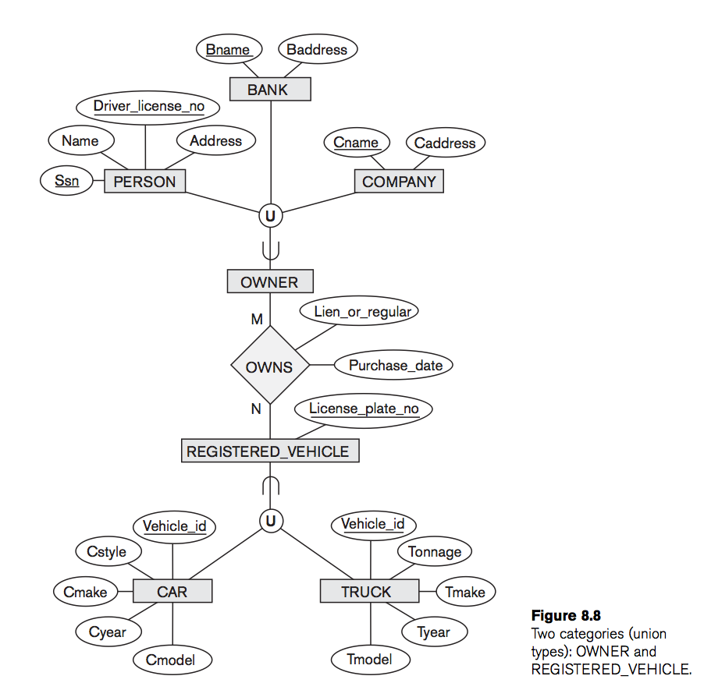
Modeling of UNION Types Using Categories
Union type or a category
Represents a single superclass/subclass relationship with more than one superclass (disjoint, not overlap)
Subclass represents a collection of objects that is a subset of the UNION of distinct entity types
Owners ⸦ {Persons U Banks U Companies}
Attribute inheritance works more selectively
Some modeling methodologies do not have union types

Slide 30
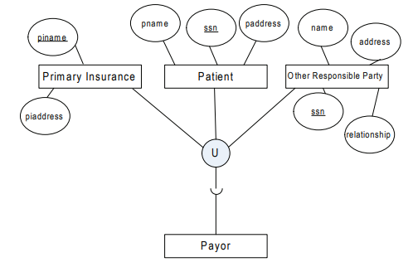
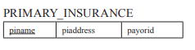
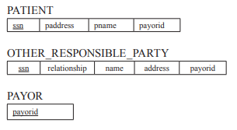
Mapping Union type or a category into Relational Database Schema
Case 1: The superclasses have different keys
Create a new key attribute (called a surrogate key) to correspond to the category in the new relation .

Slide 31
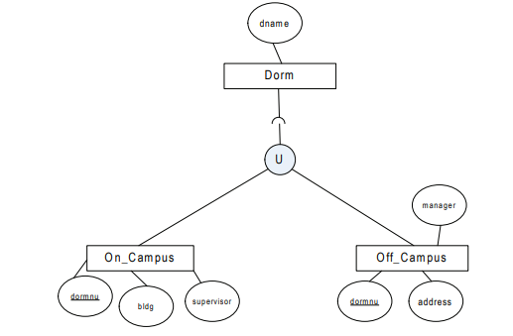
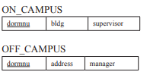
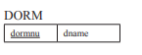
Mapping Union type or a category into Relational Database Schema
Case 2: The superclasses have the same key

Slide 32
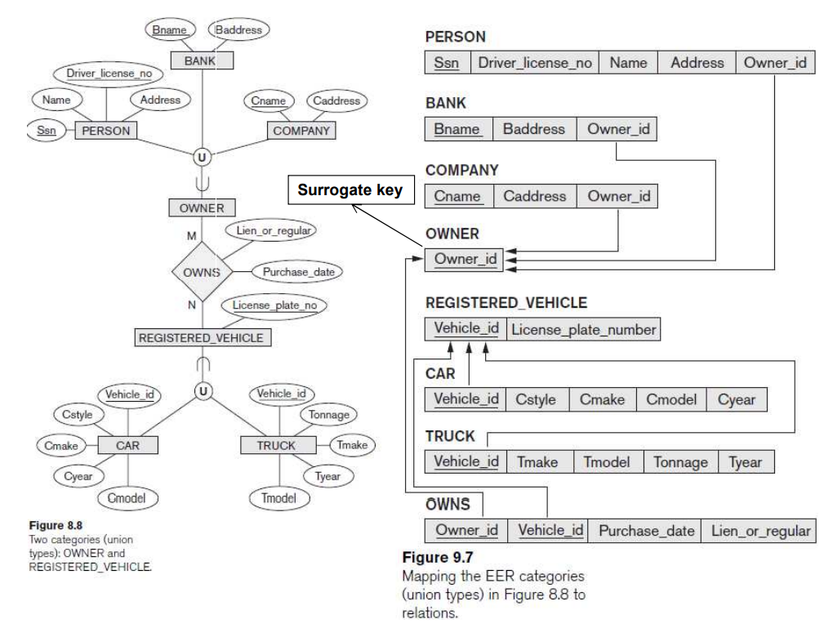
Mapping UNION (category)Types into Relational Database Systems
Notes:
INHERITANCE DIRECTION
All of the superclass/subclass relationships we have seen thus far have a single superclass. A shared subclass such as ENGINEERING_MANAGER in the lattice in the EMPLOYEE Figure is the subclass in three distinct superclass/subclass relationships, where each of the three relationships has a single superclass. However, it is sometimes necessary to represent a single superclass/subclass relationship with more than one superclass, where the superclasses represent different entity types. In this case, the subclass will represent a collection of objects that is a subset of the UNION of distinct entity types; we call such a subclass a union type or a category.

Slide 33
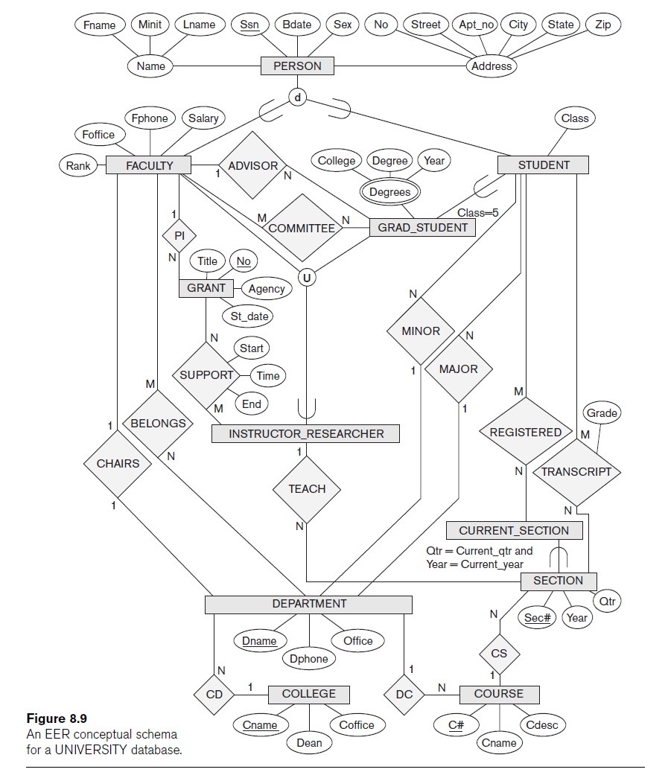
A Sample UNIVERSITY EER Schema, Design Choices
The UNIVERSITY Database Example
Students and their majors
Transcripts, and registration
University’s course offerings

Slide 34
Example of Other Notation
Representing specialization and generalization in UML class diagrams
Base class
Root superclass
Leaf classes
Subclasses (leaf nodes)

Slide 35
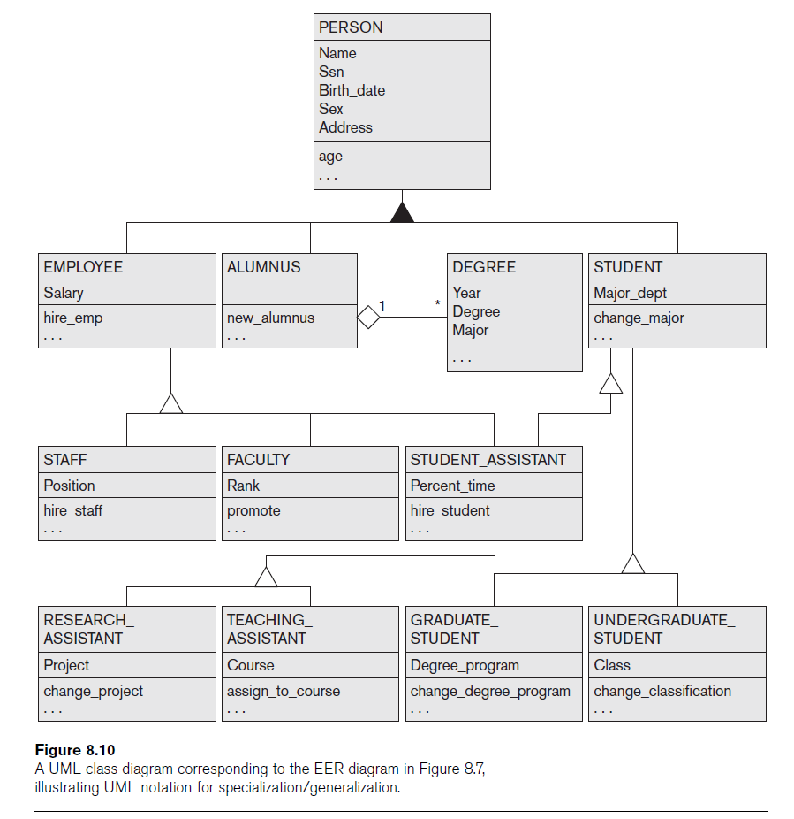

Slide 36
Summary
Enhanced ER or EER model
Extensions to ER model that improve its representational capabilities
Subclass and its superclass
Category or union type
Notation and terminology of UML for representing specialization and generalization

